Slide 1
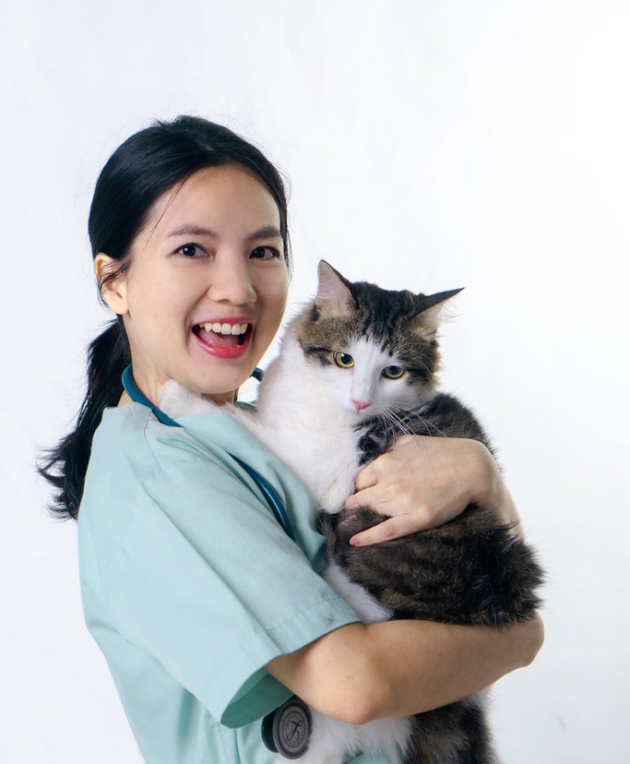
PetVax
Senior Project
Spring 2023
This Photo by Unknown Author is licensed under CC BY-NC

Slide 2
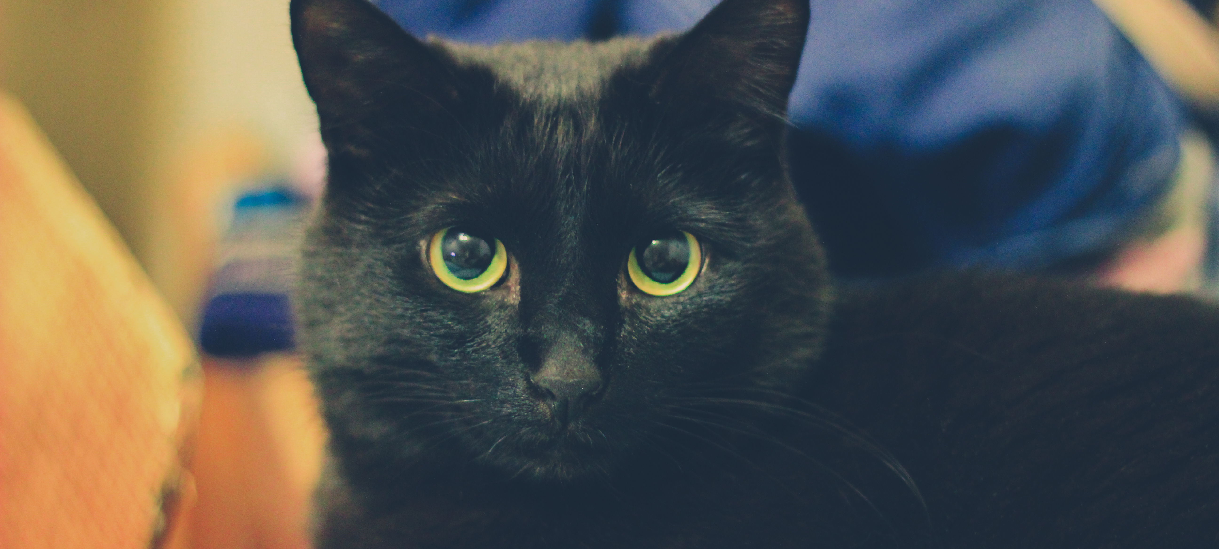
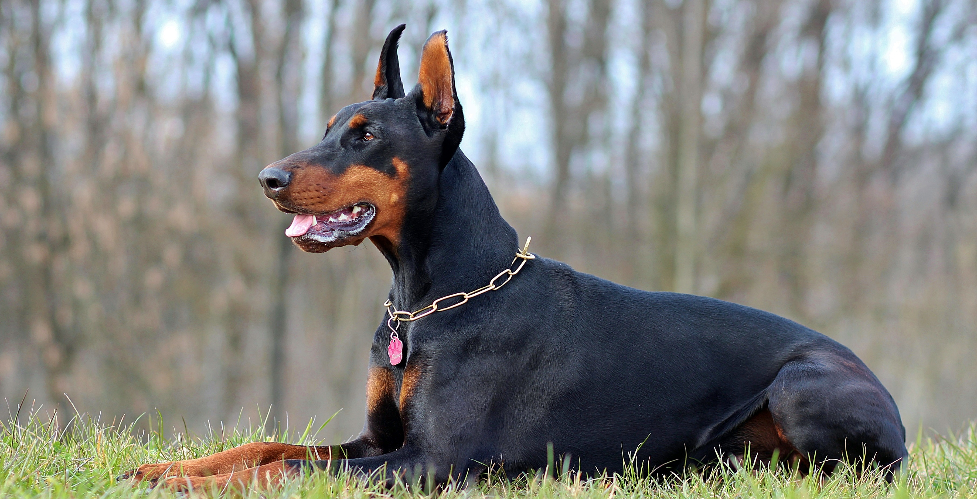
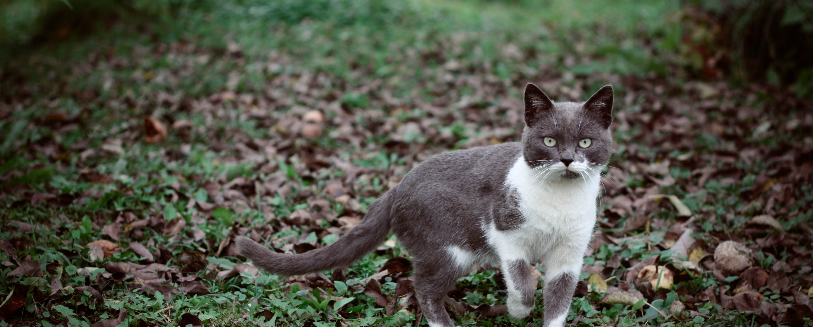
Agenda
Introduction
Prototype
Team Dynamics
Planning & Tools
Demo
Swagger UI
Future Implementations

Slide 3
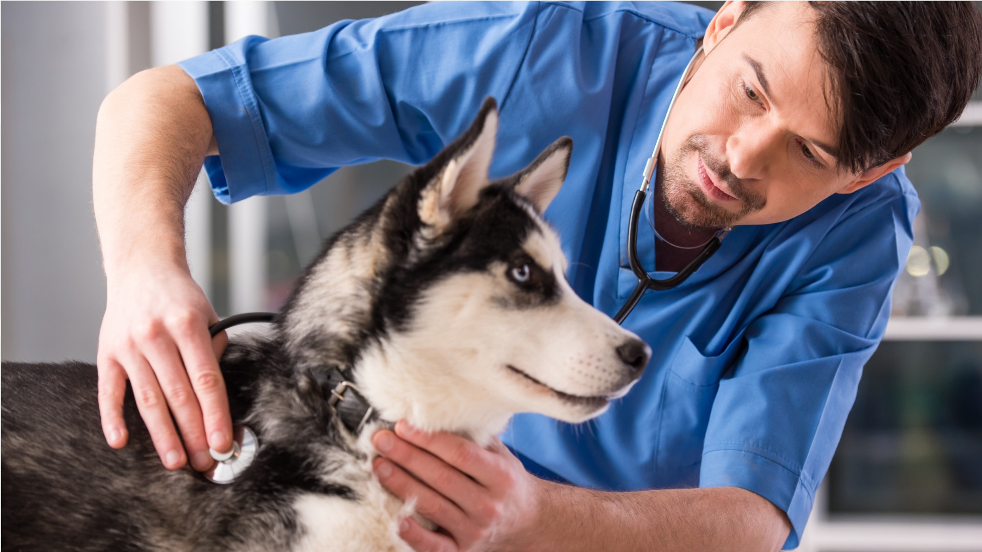
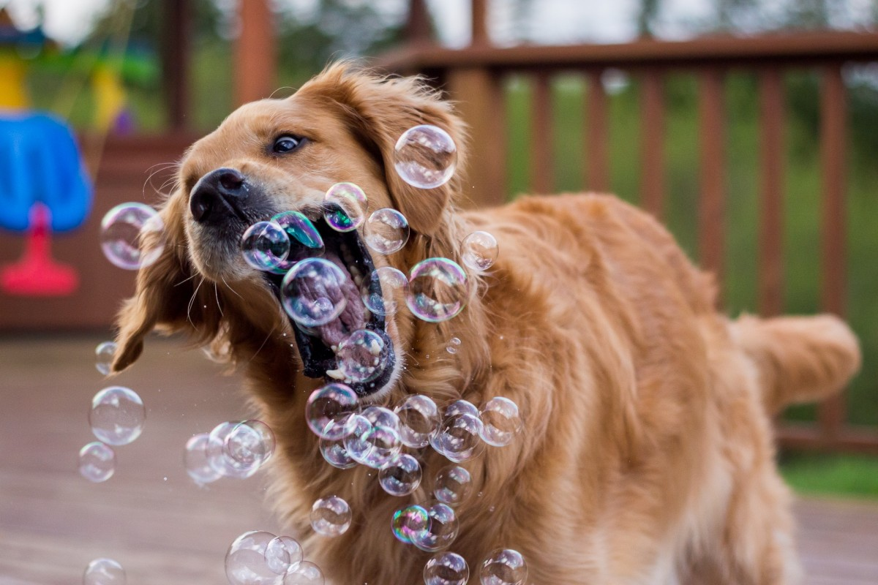
Introduction
Objective of PetVax application:
Potential impacts:
Positive environmental impact:
Create an all-inclusive website or application for pet owners to manage pet vaccinations and veterinary records/appointments.
Improved communication between veterinary professionals and pet owners, streamlined appointment scheduling, record keeping, and paperless operations for veterinary clinics.
Contributing to global efforts to reduce carbon footprints and deforestation by promoting paperless operations in veterinary clinics.
This Photo by Unknown Author is licensed under CC BY

Slide 4
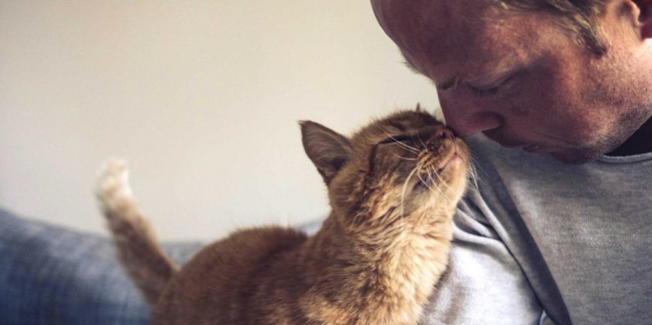
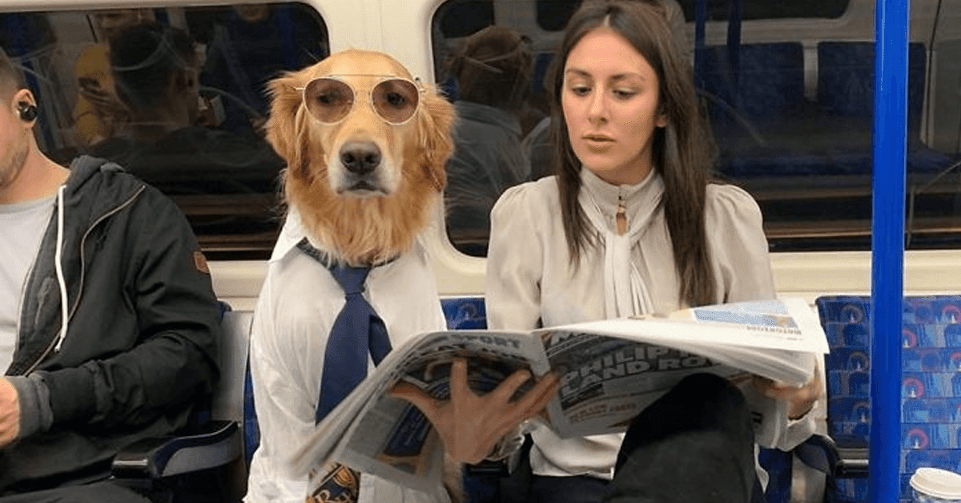
Continued…
Economic demand:
Rising societal trend of pet ownership creates a need for an easy-to-access, digital solution for managing pet records and appointments.
Statistics:
66% of U.S. households own a pet (Forbes, April 10, 2023).
Over 70% of childless households own a pet (Psychology Today, August 24, 2021).

Slide 5
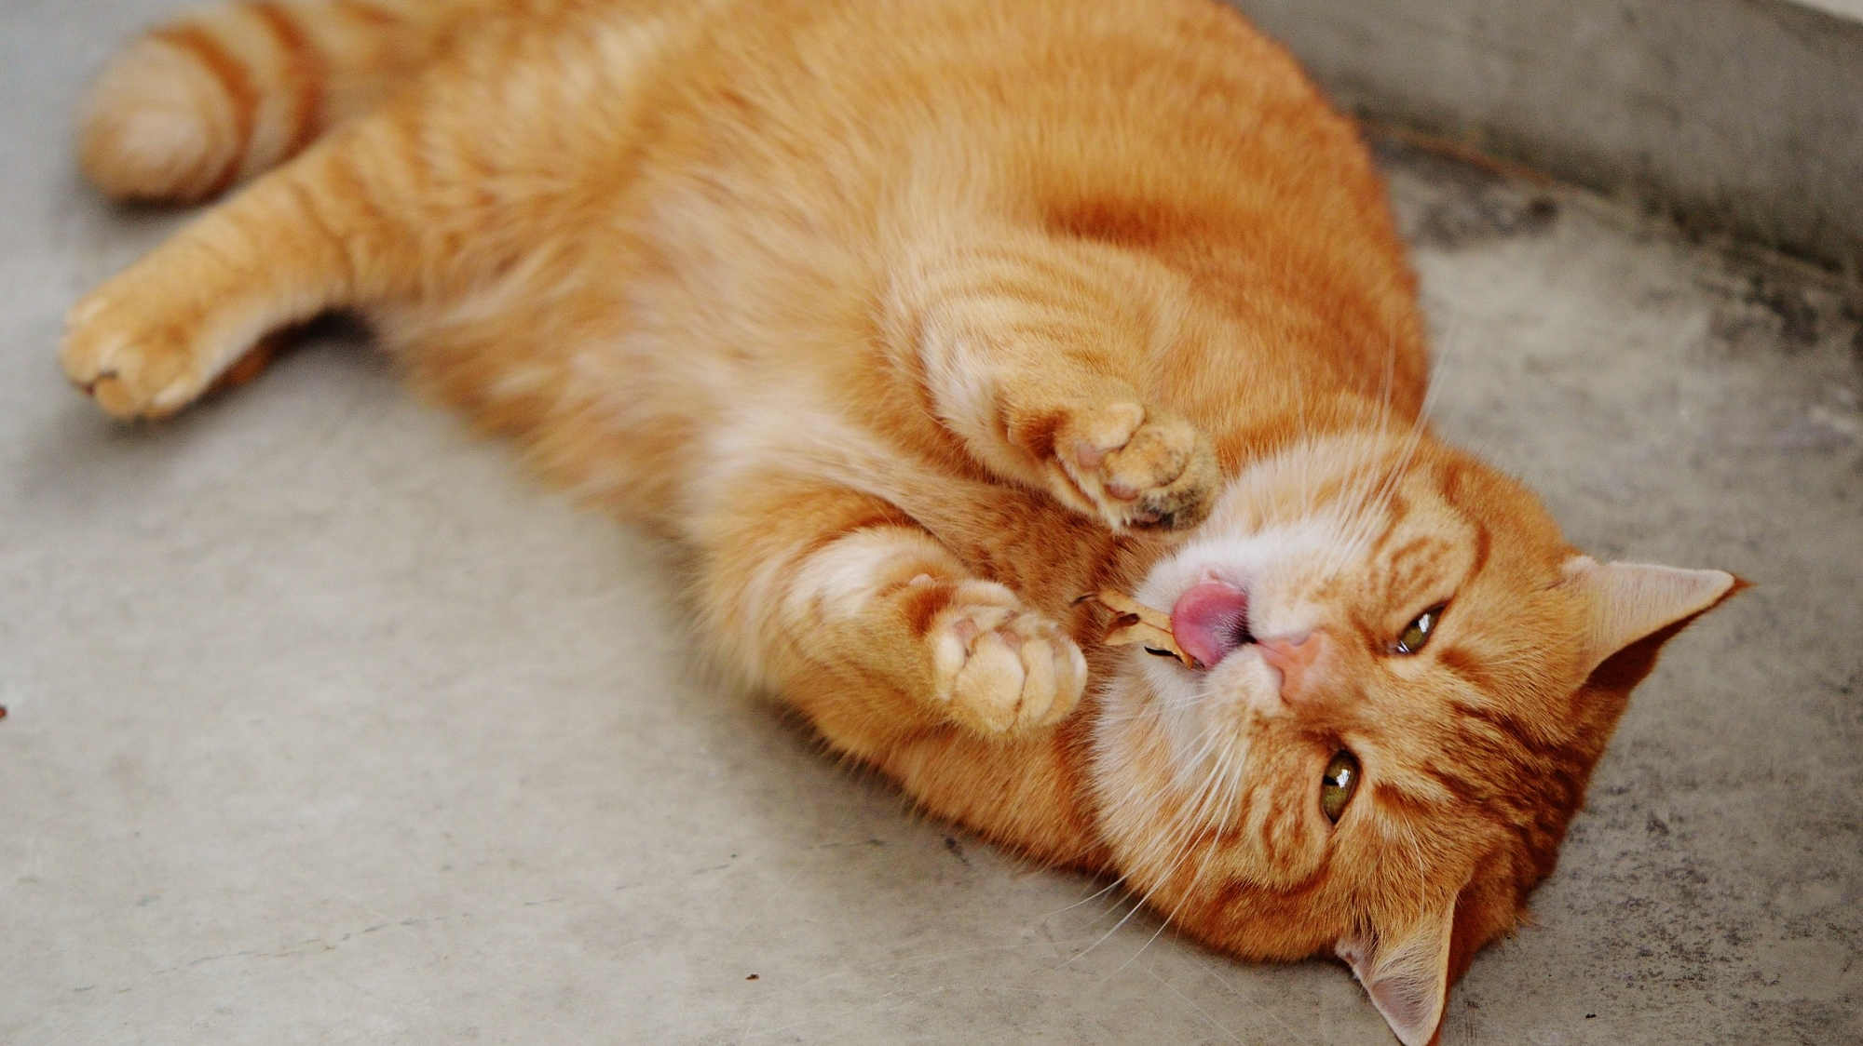
Prototype
Walkthrough in Figma
(Take it away Rishikesh!)

Slide 6
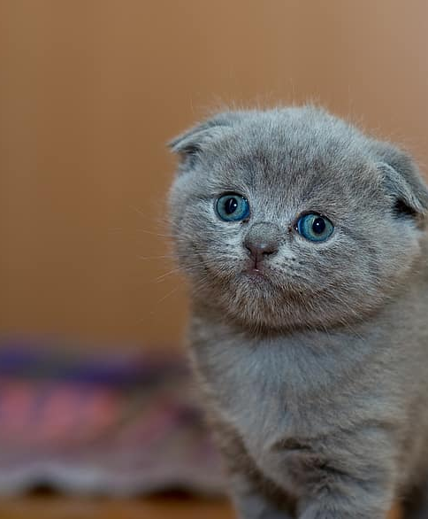
Team Dynamics
(Take it away Corey!)

Slide 7





Team: Care Bears
Corey Newman
Luis Grados Virto
Connor Lengyel
Rishikesh Katthi
Averi Biondo
Back-End
Front-End
Back-End
Front-End
Back-End

Slide 8
Team Charter
Code of Conduct:
Work proactively to prevent potential problems.
Keep team members informed about project-related information.
Be honest, share ideas, and have an open mind without malicious intent.
Communicate in advance if unexpected situations arise that may affect task completion deadlines.
Participant:
Be honest and open during all project activities.
Be open to new approaches and ideas.
Have one discussion at a time.
Be respectful and compliant.
Communication:
Use Discord text and voice channels for quick Q&A/feedback.
Hold in-person meetings for communication.
Use personal communication only if necessary and approved by participants.
Problem-Solving:
Encourage everyone to participate in problem-solving.
Build on each other's ideas.
Respect members' time and ask for feedback in advance.
Ask for help when needed and understand that not everyone is an expert
Be solution-focused and brainstorm ideas to resolve issues presented by any member.
Meeting Guidelines:
Held face-to-face meetings every Friday during class time and progress reviews every Wednesday with Professor TK
Close decisions and identify action items.
Assess Jira items requiring reviews and propose changes or approve based on decisions made.
Seek everyone's opinions and feedback on documents and tasks.
Conduct code reviews with at least one front-end member reviewing back-end code and vice versa.
Practice patience and avoid interrupting current speakers.
Record meeting outcomes and share reports with participants.
Held other necessary meetings via Discord text and voice channels.

Slide 9
Experienced Complications - How were they resolved?
Issue: Communication
Resolution: Team used multiple medias for communication including: Discord, GitHub, Jira, email, shared Google folder, telephone, and face-to-face conversations.
Issue: Team Availability
Resolution: Team members prioritized discussions in Discord and within scheduled class times. Some team members scheduled meetings to accommodate other team members schedules.
Issue: Prioritization of Tasks - Backend-Frontend Integration (HTTP Client)
Resolution: Team took a pair programming approach and focused on connecting individual parts and then leveraged one another’s experience during those implementations to assist in troubleshooting other’s hurdles.
Issue: Knowledge - Programming Languages & Technologies
Resolution: Team prioritized spikes to investigate new technologies as well as leveraged demos to other team members during scheduled class times and meetings.

Slide 10
Communication (discord, meetings) & complications
Complications:
Lack of knowledge and 1 Sprint spend on learning the basics
Absence from participants
Lack of communication from participants

Slide 11

Planning & Tools
(Take it away Connor & Luis!)

Slide 12
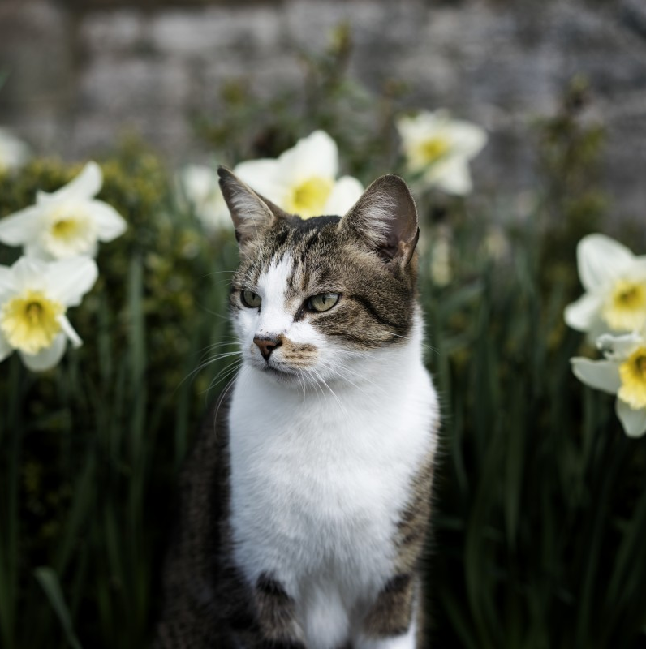
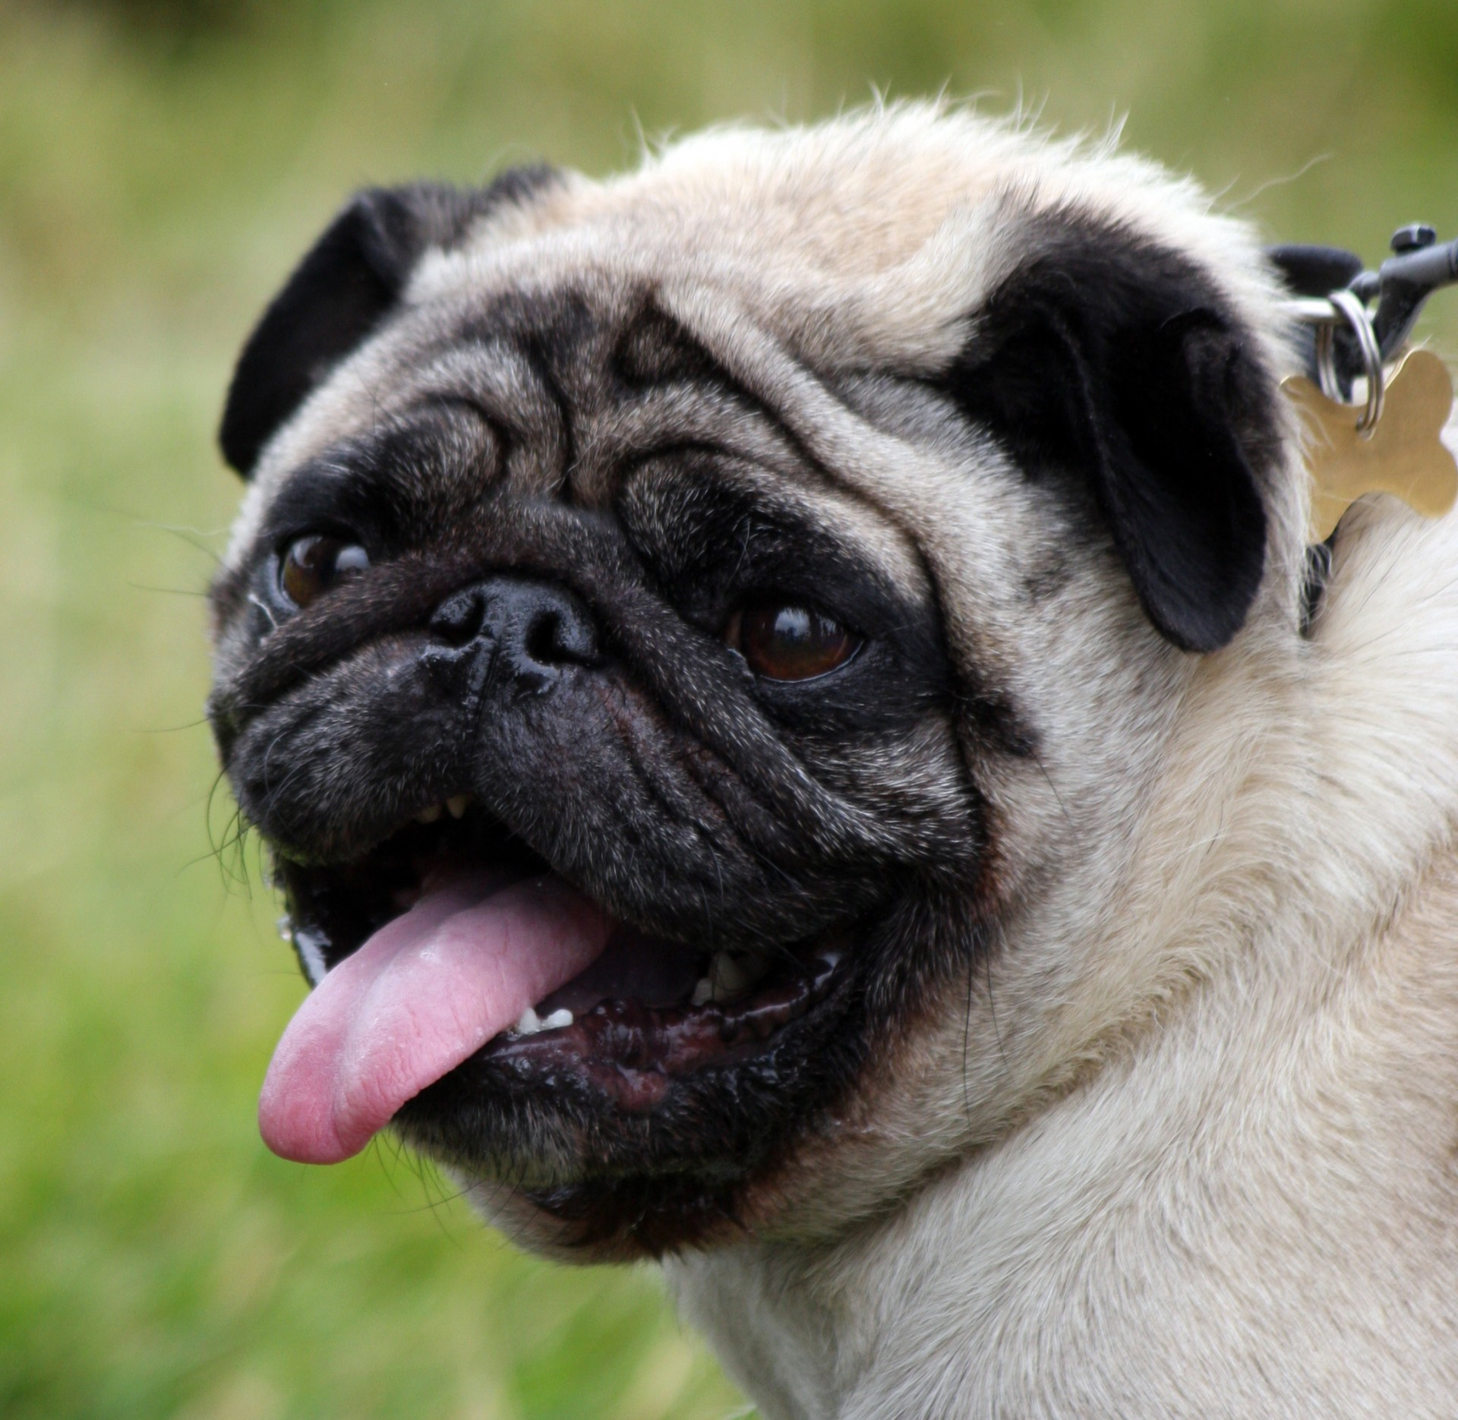
Project Tool/Languages
 | Prototype | Front-End | Back-End
 | Figma | Angular Framework | Spring Boot Framework Spring Security (Auth) Swagger (Documentation)
 |  | HTML | Database: SQL
 |  | CSS | Docker: phpMyAdmin, MySQL DB
 |  | TS

Slide 13
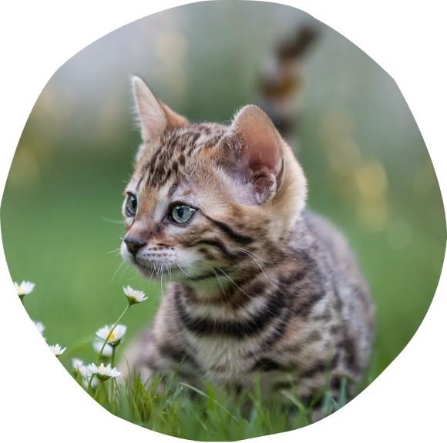
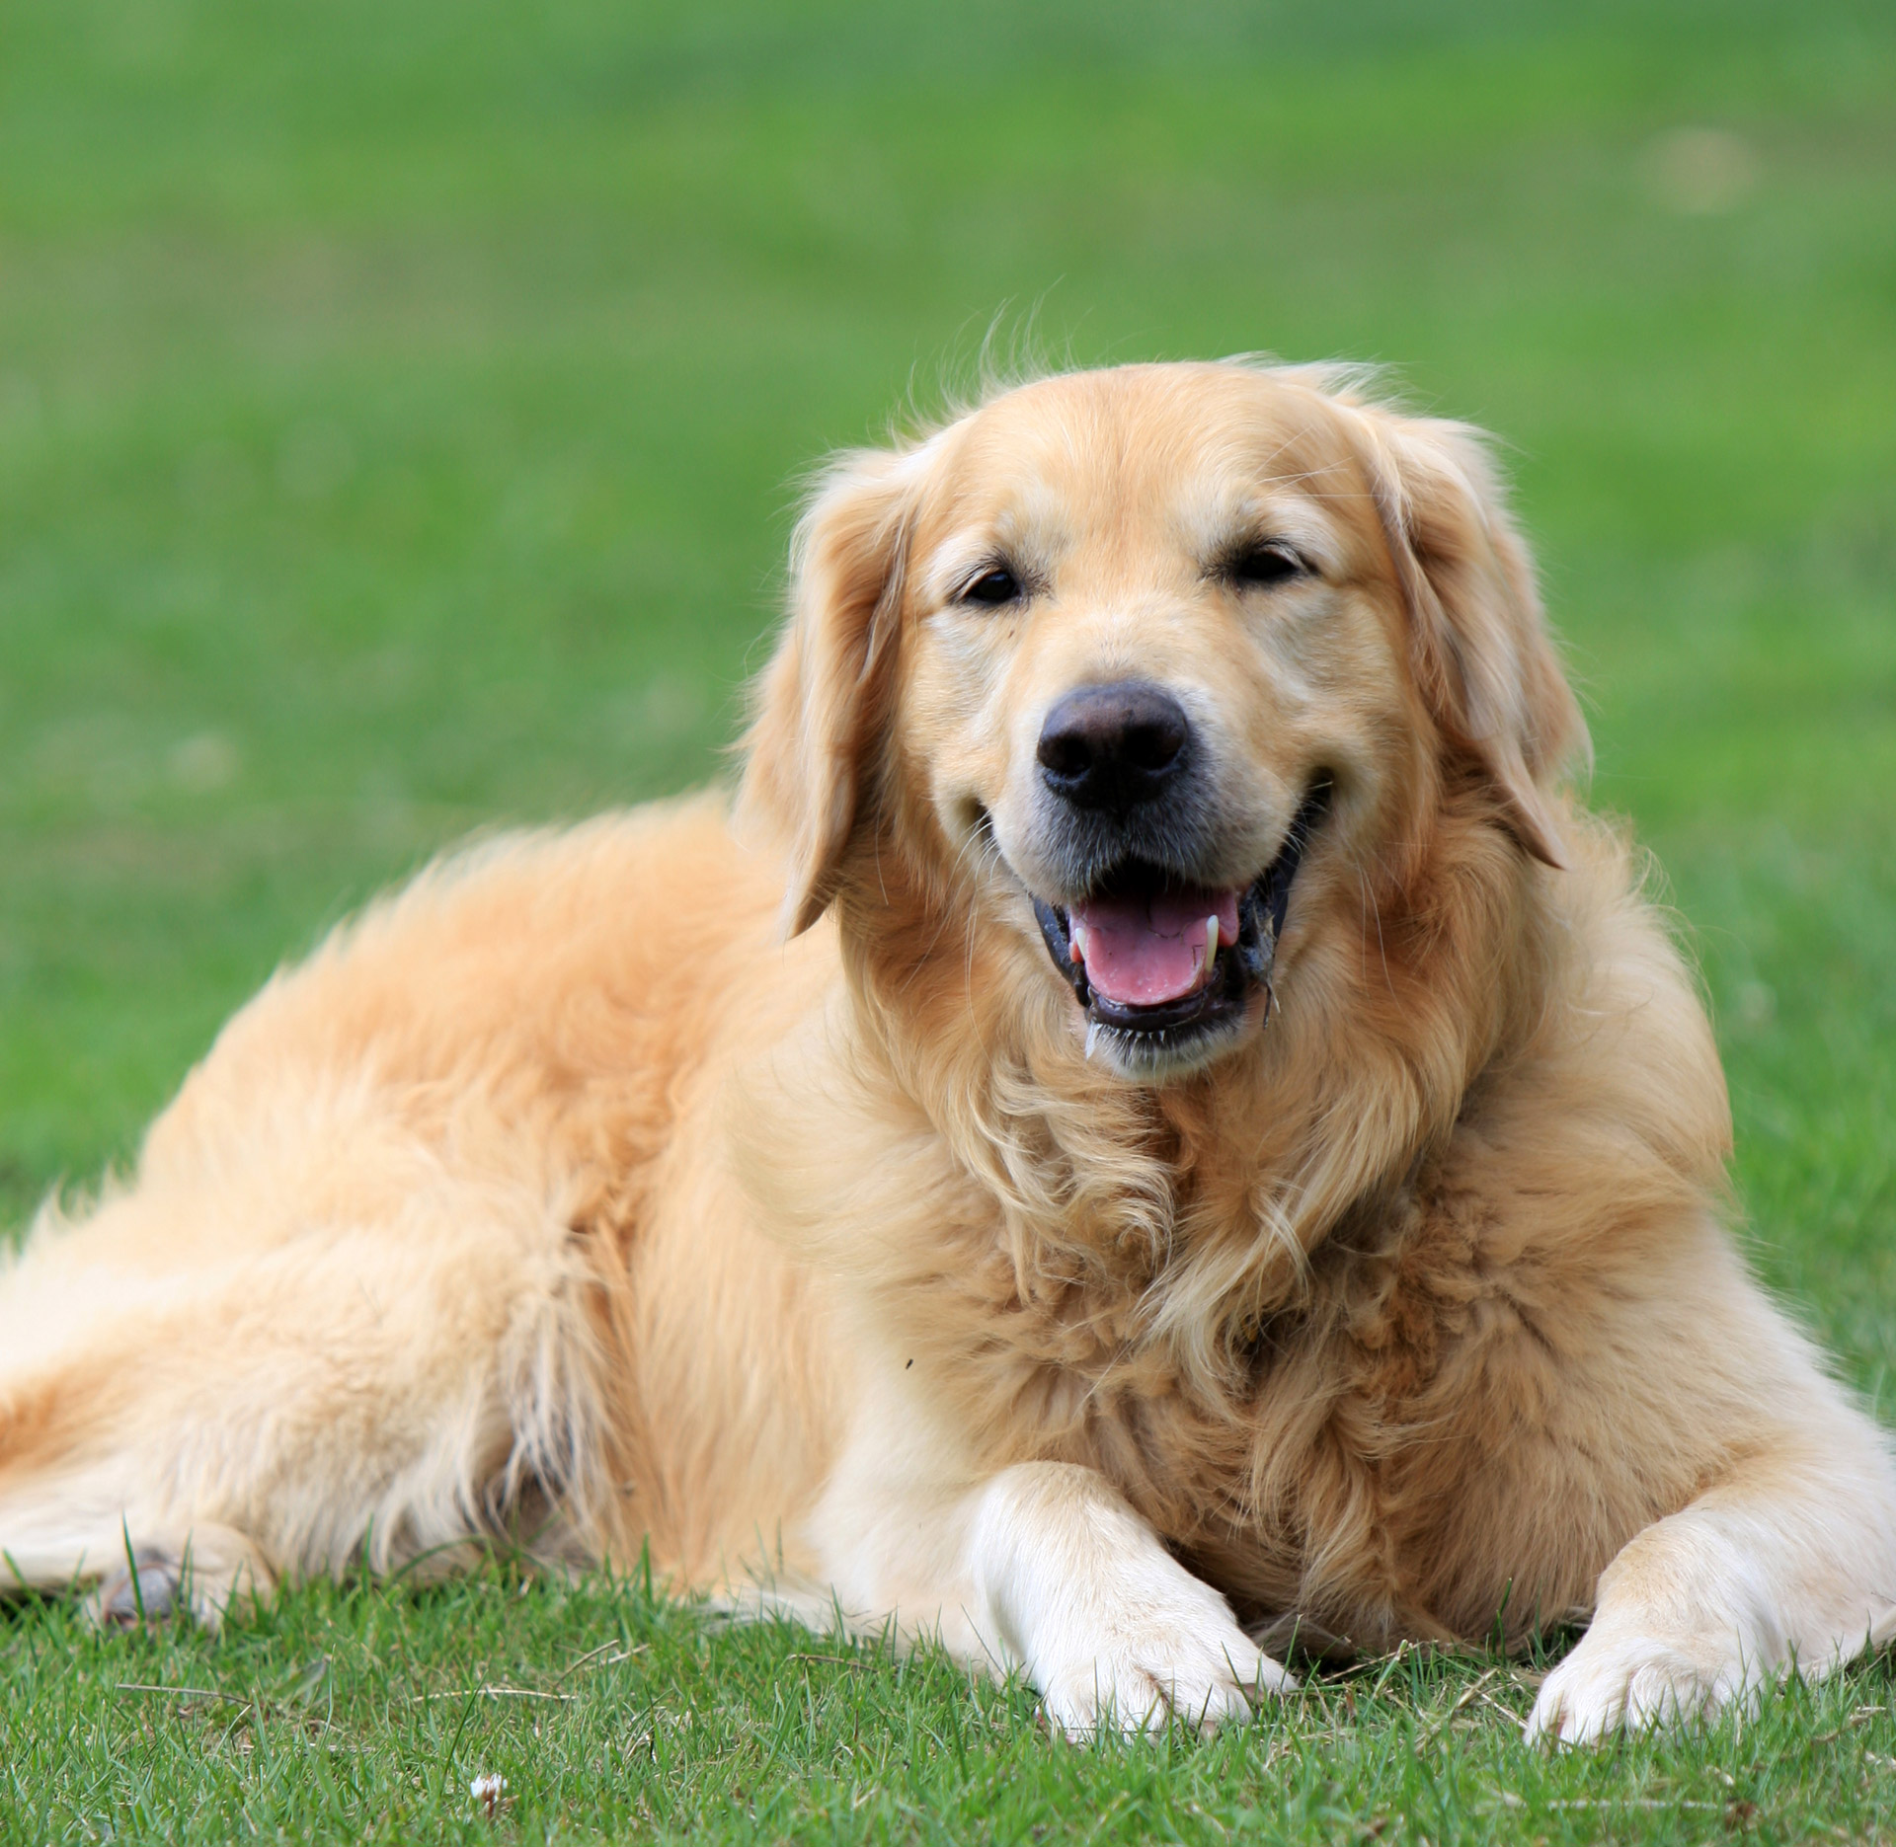
Project Tools/Languages
Prototype:
Figma
Front-End:
Angular Framework (HTML, CSS & TS)
Back-End:
API: Java Spring Boot
Database: SQL

Slide 14
Front-End Structure
Services folder to contain the HTTP code.
Components folder to contain subdirectories per each component.
- Each subdirectory contains their respective HTML, CSS, TS files.
Assets folder to contain any resource such as images.
Petvax-app parent folder to contain Petvax-app directory.
Luis and Rishikesh were assigned to frontend development.
Rishikesh was assigned to frontend because he’s a current professional who has experience with both Angular framework and React JS library.
Luis was assigned to frontend because he’s interested in learning Angular.

Slide 15
Back-End Structure
Petvax-services parent folder to contain petvax-services directory.
Exceptions folder to store error messages and exceptions.
Controller, converter, dto, entity, repository, and service folders to create various endpoints.
Config folder for JWT security measures.
Corey, Averi, and Connor were assigned to backend development.
Corey was assigned to backend because previous years of experience developing in Java and his professional experience testing RESTful services and a Spring Boot framework.
Averi was assigned to backend because she is interested in databases, data organization, and has several years of experience (in school) coding in Java.
Connor was assigned to backend because he had multiple years of experience with Java development.

Slide 16
High level overview of JIRA, Agile Ceremonies (Scrum, Planning, Retro)
We used JIRA to organize two week long sprints.
We met every Wednesday and Friday during class time to discuss progress and potential problems we were facing during the sprint.
If there was anything that needed to be addressed immediately and could not wait until the next meeting then Discord was used to communicate between team members.
At the beginning of our Friday meeting after a sprint ended we would go over our sprint retrospective. During the retrospective we would go over what went wrong, what went right, and what we will do to improve next sprint.

Slide 17
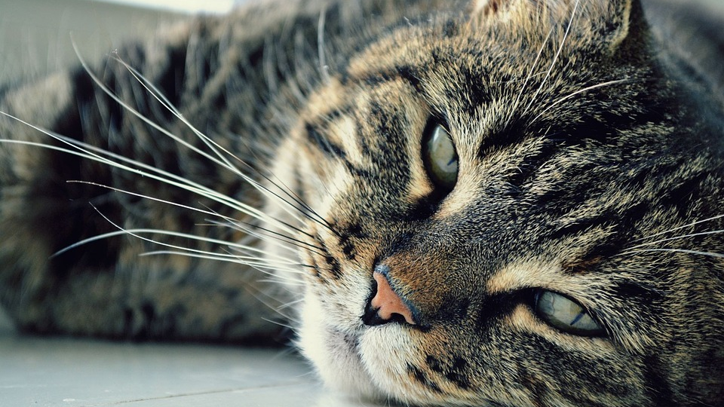
Swagger UI
Open API Documentation
(Take it away Corey!)

Slide 18


PetVax Demo
Let’s go!
(Take it away Luis!)

Slide 19
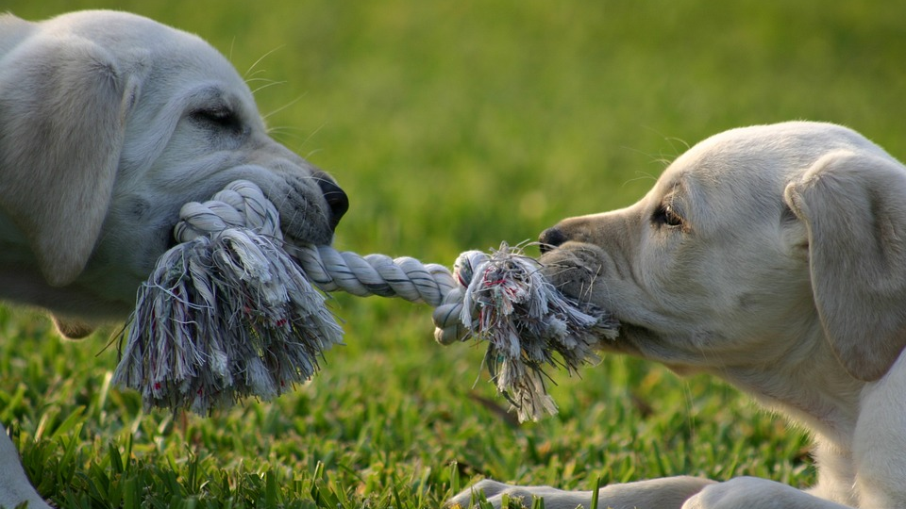
Future Implementations
(Take it away Averi!)

Slide 20

What’s Next for PetVax?
Plug-in Wallet to backend (add/edit/delete)
Owner + Pet Profiles
Provide Geo-mapping
Appointments - Scheduling + Notifications
Services Clean-up (in Angular)
PetVax Admin
Addition of Test Results

Slide 21
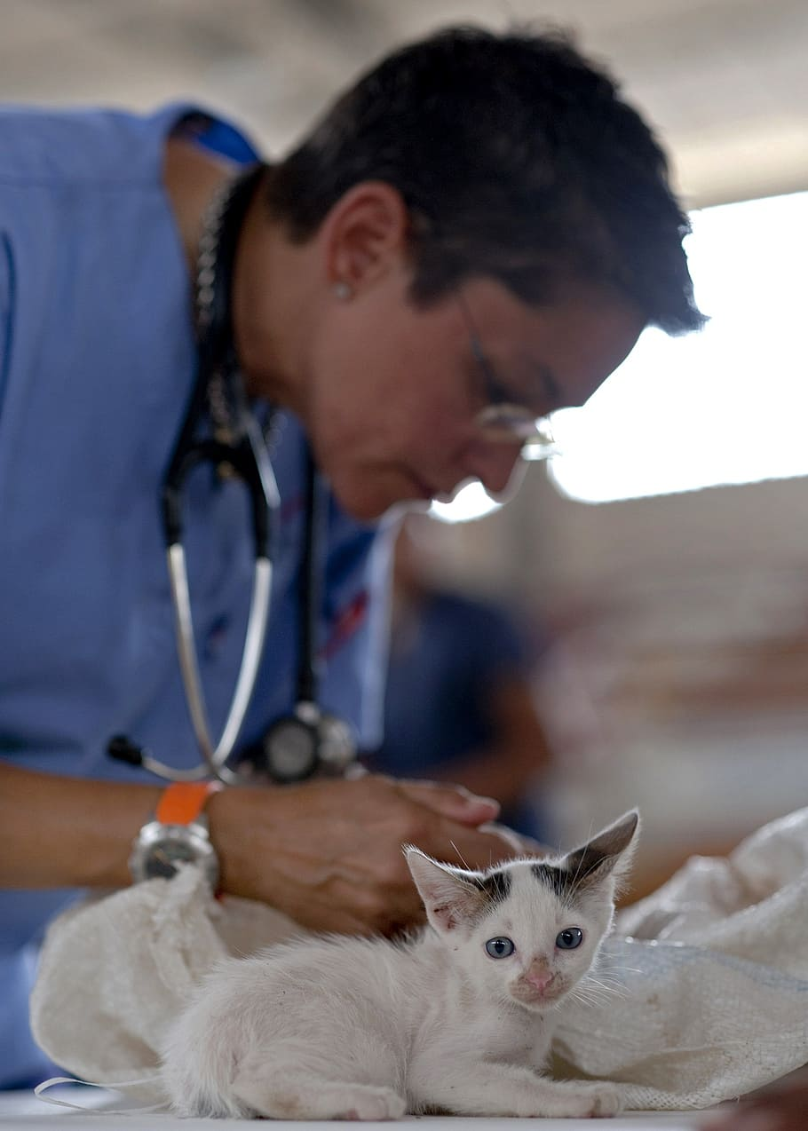
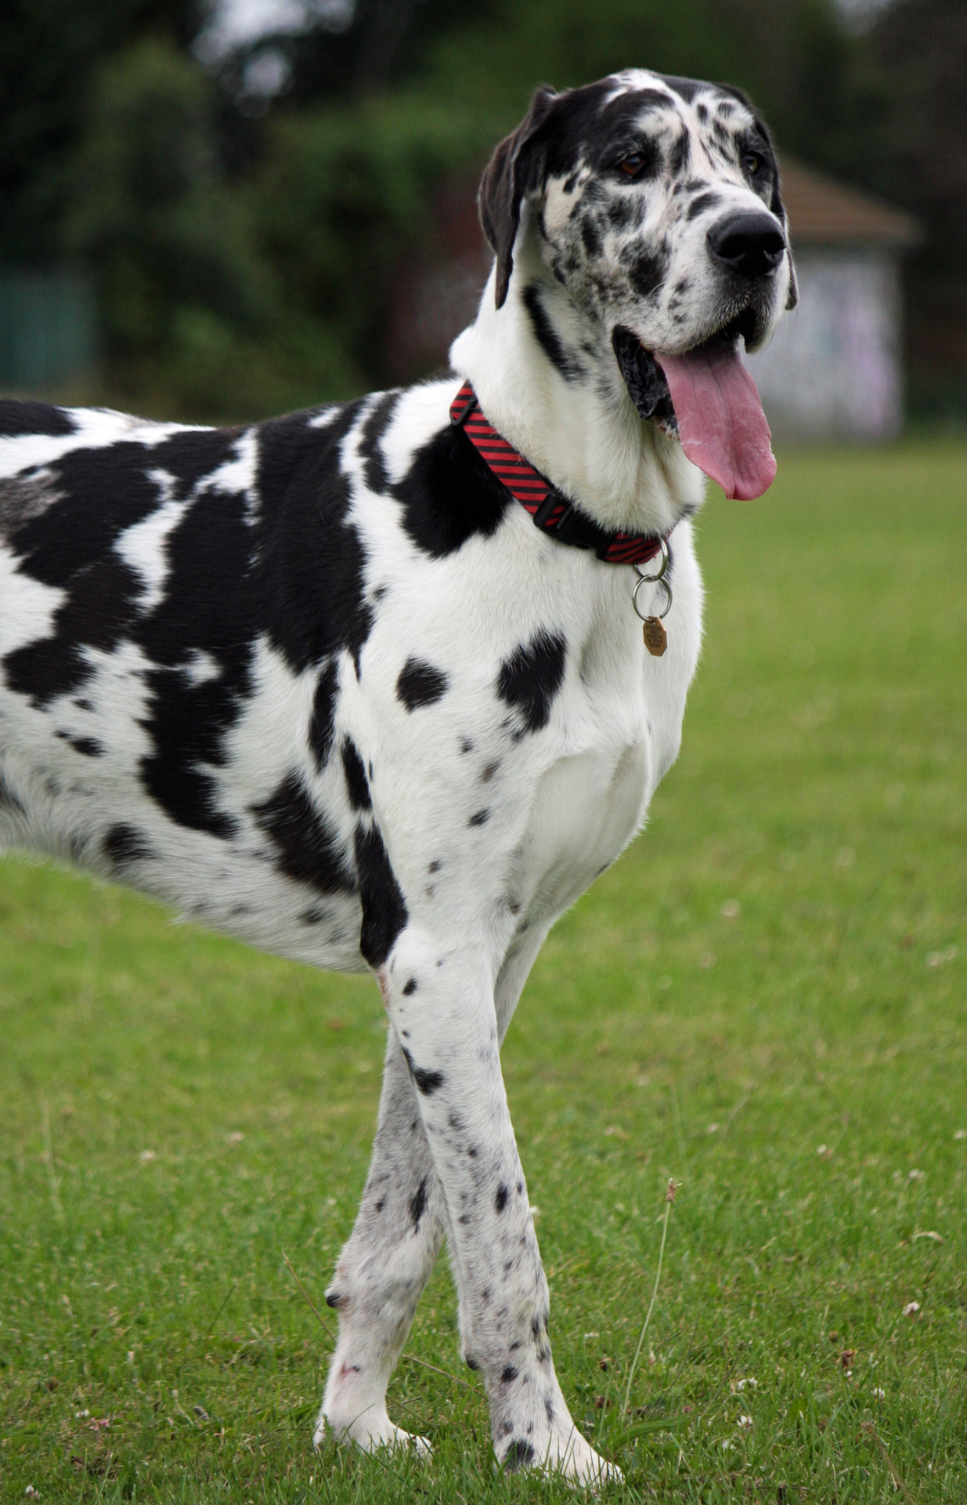
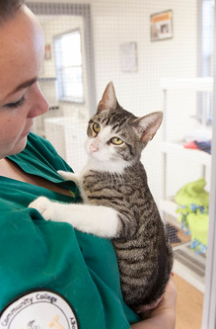
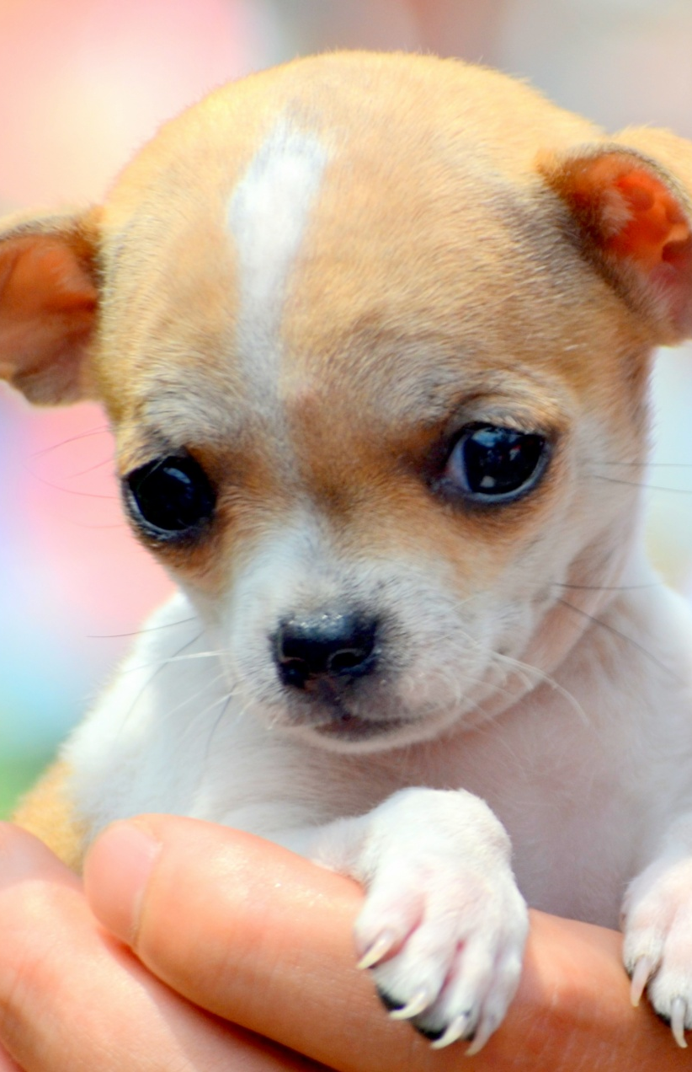
Thank you!
Add Website Here!

Slide 22
Sources
Sources (for images used for project, check sources here https://www.figma.com/file/aefoNk0vEDCPqkT7CVknGk/PetVax?node-id=52-4)

